Slide 1

Intel 64-bit processor

Slide 2

Team Introduction and Roles
Tugs: History of Intel processors, CPU architecture, hyper-threading and caching
Jhonatan: CPU memory management architecture
Sarah: Instruction set architecture, sample instructions and stack management
Liz: Sample program written in C

Slide 3
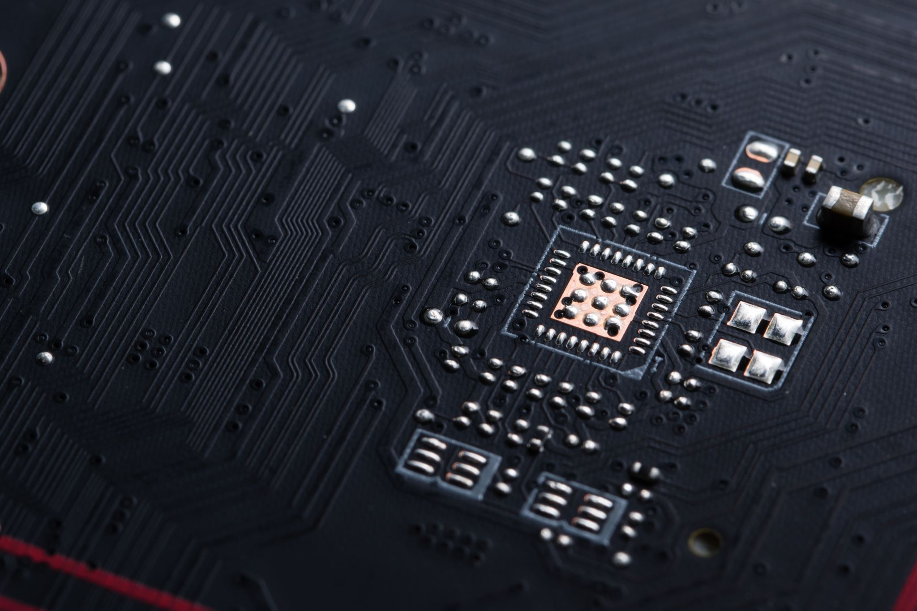
Evolution of Intel Processors
1971: Introduction of the Intel 4004
The first commercially available microprocessor
1974: Introduction of the Intel 8080, served as the “brain” of the early personal computer
1978: Release of the Intel 8086
Intel’s first 16- bit microprocessor
1987: Release of the 386
Intel’s first 32-bit microprocessor
1993: Launch of the Intel Pentium
Optimizing power efficiency and performance
2021: Continued innovation with the 11th Gen Intel Core Processors.

Slide 4
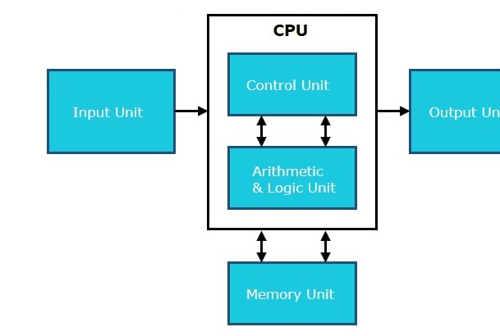
CPU Basics
Arithmetic Logic Unit (ALU)
Control Unit
Registers
Bus

Slide 5
CPU Architecture of 64-bit Intel Processor
Cores: Multiple independent processing units within a single chip
Enhanced performance and multitasking capabilities
Dual-core to octo-core configurations
Benefits of Multiple Cores:
Increased Processing Power
Enhanced multitasking
Scalability

Slide 6

Hyper-Threading Technology
What is a hyper-threading technology?
Each physical core can handle multiple software threads simultaneously
Improves resource utilization and multitasking performance
Virtual cores enable better execution of parallel tasks.
Benefits of Hyper-Threading:
Improved Resource Utilization
Increased Responsiveness

Slide 7

Caching Mechanisms
What is caching and its importance in CPU architecture?
L1, L2, L3 caches: Hierarchical levels of memory stage
L1 cache: Closest to the core, stores frequently used instructions and data
L2 and L3: Larger but slightly slower, provide additional storage for future access
Benefits of caching;
Faster Data Access
Reduced Memory Latency
Improved Performance

Slide 8
64-bit computing
What is 64-bit computing?
Benefits of 64-bit architecture over 32-bit
Increased memory addressability
Enhanced performance in handling large datasets and complex calculations
Support for more extensive software and applications
Improved security features

Slide 9

Advantages of 64-bit Intel Processors
Increased Memory Addressability:
Efficiently addresses larger memory spaces
Ideal for resource-intensive applications
Enhanced Performance:
Efficient instruction execution and floating-point calculations
Better utilization of system resources
Compatibility
Industry-standard architecture
Compatibility with current and future software releases
Enhanced Security
DEP, ASLR
Optimized for Modern Workloads

Slide 10

Introduction to memory management architecture in Intel 64-bit processor
Organization and design of memory management in intel 64-bit processor
Ensures efficient data access and program execution
Techniques:
Paging
virtual memory
memory management unit

Slide 11
Virtual Memory
What is virtual memory?
Virtual memory is different than physical memory
“The easiest way to think about virtual memory is to conceptualize it as an imaginary memory location in which all addressing issues are handled by the operating system.” - Linda Null (Essentials of Computer Organization and Architecture)
Utilizes the hard disk as an extension of RAM
Allows computer to access more main memory than physically installed
Virtual memory is implemented using the technique of paging

Slide 12
Benefits and limitations of virtual memory
Increases capabilities of computers by providing additional space aside from limited capacity of the CPU
Frees applications from having to share memory space
Allows you to run larger / more complex programs
Slower than RAM
Performance is worse than RAM
Increased disk usage

Slide 13
Paging
Paging in Intel 64-bit Processors
Memory management method used in Intel 64-bit processors.
Enables the use of virtual memory, expanding effective address space.
Pages are copied from disk to page frames in main memory.
Allows control over memory allocation and utilization.
Divides the virtual address space into fixed-sized pages.
Efficiently translates virtual addresses to physical addresses.
Enables the processor to access the correct physical memory location for data retrieval and storage.
Information about page locations stored in page directories and page tables.

Slide 14
Page Tables and Directories
Processor uses page directories and page tables to translate linear addresses to physical addresses.
Paging is a memory management technique allocating fixed-size page frames to processes.
Each process has its own page table, mapping virtual pages to physical locations.
Page Table Entries: Page table entries contain valid bit (0 if not in memory, 1 if present) and frame number for data location.
Processor accesses data efficiently based on page table information.
Page directory matches virtual addresses to physical addresses.
Page tables and directories form a hierarchical structure for efficient address mapping.

Slide 15
Memory Management Hierarchy
The page map level 4 (PML4)(top level data structure) — An entry in a PML4 table contains the physical address of the base of a page directory pointer table, access rights, and memory management information. The base physical address of the PML4 is stored in CR3.
A set of page directory pointers — An entry in a page directory pointer table contains the physical address of the base of a page directory table, access rights, and memory management information.

Slide 16
Memory Mangement Hierarchy (Continued)
Sets of page directories — An entry in a page directory table contains the physical address of the base of a page table, access rights, and memory management information.
Sets of page tables — An entry in a page table contains the physical address of a page frame, access rights, and memory management information.

Slide 17
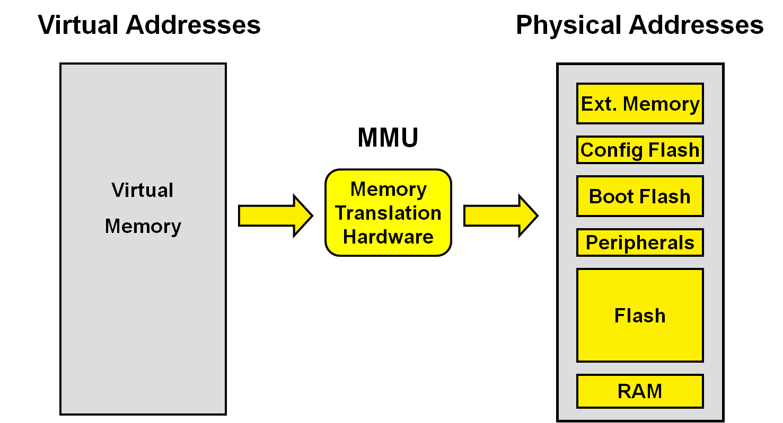
Memory Management Unit (MMU)
Memory Management Unit (MMU) is an important hardware component in memory management architecture.
MMU translates virtual addresses to physical RAM addresses, enabling efficient data access.
Responsible for implementing memory management techniques like paging in a secure manner.
MMU, along with page directories and page tables, forms the fundamental building block of memory management architecture.
Facilitates seamless address translation, efficient virtual memory implementation, and robust memory protection mechanisms.
VIRTUAL ADDRESS PHYSICAL ADDRESS
MMU

Slide 18

Introduction to Instruction Set Architectures: Understanding the core of Intel 64-Bit Processors
Intel - What is Instruction Set Architecture?
Originally known as the AMD64, soon became to be known as EM64T
x86-64 is an extension from the originally x86-32 bit
Blueprint for the CPU- communication and execution
The ISA acts as an interface between hardware and software, defining the processor's capabilities and task execution methods
No ISA means no user interaction with a computer
Referred to as a manual
Larger memory spaces

Slide 19
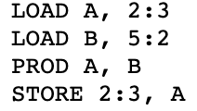
Distinguishing of the intel ISA
CISC (complex instruction set computer)
Complex arithmetic : excels with complex arithmetic
Occurs when a specific instruction is called
MULT (ex: MULT 4:2)
ADD (ex: ADD 2:3)
DIV (ex: DIV 4:2)
SUB (ex: SUB 2:1)
RISC
Relies on simple instruction --> One clock cycle
Ex: MULT would be turned into 4 steps
Can be found in mobile devices

Slide 20
VLIW (very long instruction word)
Complexity of the complier
Used in graphics processing, multimedia applications, and digital siginal processing
Superscalar implementation
Superscalar: ability to complete the more than one fetch, decode and execution instruction per one cycle time
To implement superscalar architecture , multiple execution units are required to ensure that data dependencies and errors/hazards are managed.

Slide 21

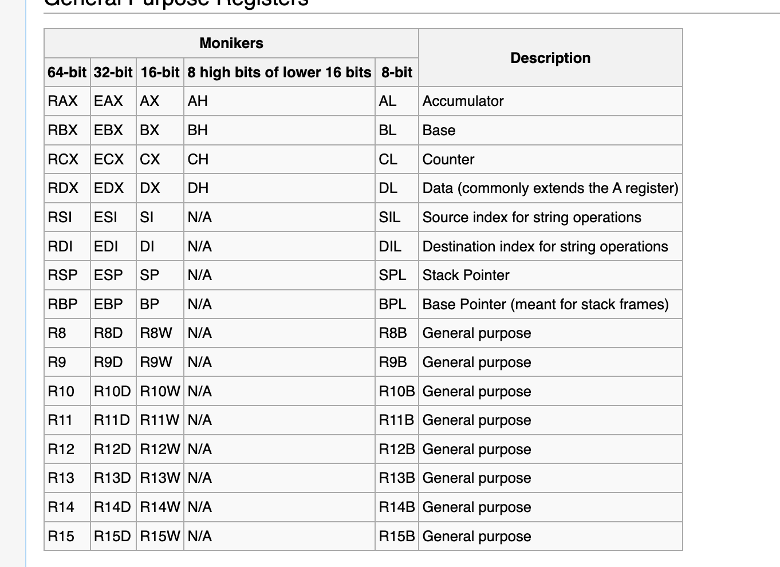
The Power Within: Exploring the Intel Processor Registers
Types of registers
General Purpose
Segment
Control
Floating Point
Debug

Slide 22
Importance of registers
Located within the CPU
Used to quickly retrieve, retain, convey data and instructions currently in use by the CPU
With the evolvement of 16-bit to 32-bit and then to x86-64 there is a total of 52 sub-registers

Slide 23
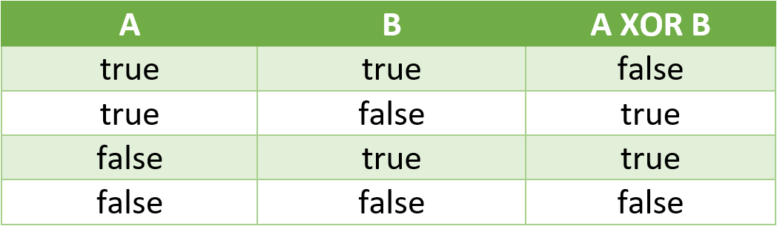
General Purpose Registers
Types of General Purpose Registers
RAX
RBX
RCX
RDX
Usage
Data Manipulation --> ex: sorting in alphabetical order
Arithmetic operations --> 1 + 2
Logical calculations (AND, OR, XOR)

Slide 24
Segment Registers
Usage: used for facilitating the building of relocated and re-entrant programs with ease
Rarely found in a 64 bit processor
Only support the CS, DS, ES, FS, AND GS (x86-32 Bit)

Slide 25
Control Registers
Usage
Fetching --> Decoding --> Executing
Types of control registers
CR0
Can be read in two ways
Legacy Mode (refers to a 32 bit): CR0 register can be accessed as a 32- bit register
Long Mode (refers to a 64-bit): all 64-bits are accessible
*the execution of the legacy to long mode is due to the backward compatabiltiydesign, thus the processor can switch between legacy and long mode to handle 32 and 64 bit instructions
CR2
Page fault liner is held here, used for when page fault occurs
CR3
Stores the physical address of the page directory and pointer table
CR4
Helps support large pages and enables hardware error reporting

Slide 26
Floating point Registers
Usage
Registers XMM0-XMM15 are used for handling floating point operations and SIMD (Single Instruction Multiple Data instructions)
Each XMM register holds 4 single floating point numbers (in 32-bit) or two double precision point (64 bits each)
Within the XMM registers, better performance in audio and video processing are enhanced

Slide 27
Debug Registers
Types of Debuggers
Data breakpoint registers (DR0-DR3
Used to set hardware breakpoints (halts the execution of a program when a specific address is accessed) *NOTE THAT WHEN IT REACHES THAT POINT, A DEBUGGER EXPECTIOPN IS TRIGGERED TO STATE WHERE THE PROGRAM IS
Reserved Registers (DR4-DR5)
Strictly reserved to do "nothing", they are set aside for potential future extensions or enhancement to the instruction set
Debug Status Register (DR6)
Used to inform the debugger about the reason for the debug event
Debug Control Registers (DR7)
Triggers breakpoints such as read, write and determines whether the breakpoint should apply to specific threads or all threads

Slide 28

Exploring Sampe Instructions
It is a sample of assembly language
Ex: Mov eax, 42
Mov = move
Eax = one of the general purpose registers
42 = value being moved into eax

Slide 29
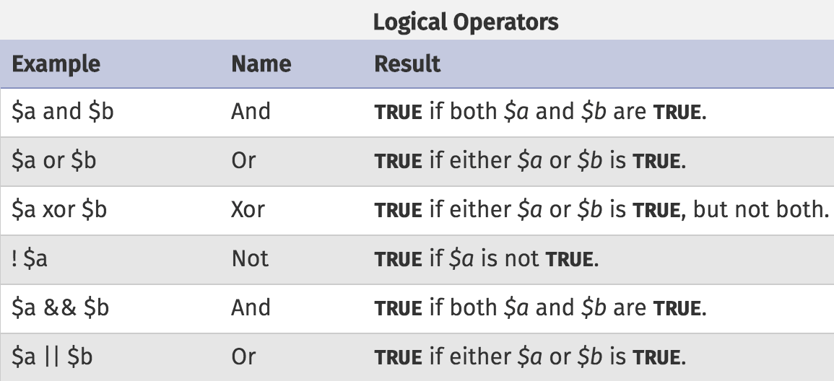
Example of Sample instructions
Arithmetic
ADD : adding two operands together
Ex: ADD Y to AC
SUBT: subtracting one operand from another
Ex: SUBT A
MULT: multiplying two operands together (signed)
DIV: dividing two operands together
Logic
AND : perform bitwise AND between two operands
OR: perform bitwise OR between two operands
XOR: perform bitwise exclusive or between two operands
NOT: negate the bits of an operand

Slide 30
Data Movement
Helps move data around from one place to another
Types of data movement
Load : when data is moved from the memory to the register
Store: the process of moving data from the register to the memory
Move: moves data from another register into another
Immediate load: helps move address to the register
Control transfer instructions
Helps control the program execution flow
Ex: CALL, will call the procedure
Into : will interrupt on overflow (COME BACK)
SIMD
when it comes to packed bytes, double words within the MMX register or words, the SIMD instruction helps perform operations
Ex: PAVGB → determine the average of unsigned byte integers (packed)
Ex: PINSRW → inserts the word
Ex: PEXTRW → helps extract the specific word

Slide 31
Exploring Stack Management
Stack Management
Is a region of memory used to organize function calls and store temporary data during program execution
Push : adds on
Pop : removes
How does it operate?
Operates as LIFO – last in, first out
The pointer points to the top of the stack, and it holds the memory address of the last item that is "pushed" onto the stack
A new function call frame is created onto the stack to store information related to execution
RBP: points to base of current function call frame --> helps access local variable
Stack Cleanup: after execution, call frame is deallocated, and pointer is restored to previous position before function call

Slide 32
References
Bigelow, Stephen J. “What Is a 64-Bit Processor (64-Bit Computing)?” Data Center, 9 Mar. 2022, www.techtarget.com/searchdatacenter/definition/64-bit-processor.
By. “Intel® 64 and IA-32 Architectures Software Developer Manuals.” Intel, www.intel.com/content/www/us/en/developer/articles/technical/intel-sdm.html. Accessed 21 July 2023.
“Computer - CPU(Central Processing Unit).” Tutorialspoint, www.tutorialspoint.com/computer_fundamentals/computer_cpu.htm#:~:text=Computer%20-%20CPU%20%28Central%20Processing%20Unit%29%201%20CPU,the%20operation%20of%20all%20parts%20of%20the%20computer. Accessed 21 July 2023.
“Computer Registers - Javatpoint.” Www.Javatpoint.Com, www.javatpoint.com/computer-registers#:~:text=Registers%20are%20a%20type%20of,often%20termed%20as%20Processor%20registers. Accessed 21 July 2023.
Control Transfer Instructions (X86 Assembly Language Reference Manual), docs.oracle.com/cd/E19120-01/open.solaris/817-5477/eoizl/index.html. Accessed 21 July 2023.
“CPU Registers X86-64.” CPU Registers X86-64 - OSDev Wiki, wiki.osdev.org/CPU_Registers_x86-64#General_Purpose_Registers. Accessed 21 July 2023.
Data Movement Instructions, www.d.umn.edu/~gshute/mips/data-movement.xhtml#:~:text=Data%20movement%20instructions%20move%20data,data%20from%20memory%20to%20registers. Accessed 21 July 2023.
“Definition of 64-Bit Computing.” PCMAG, www.pcmag.com/encyclopedia/term/64-bit-computing. Accessed 21 July 2023.
“Developer Help.” Address Translation - Developer Help, microchipdeveloper.com/32bit:mz-arch-memory-address-translation. Accessed 21 July 2023.

Slide 33
“Different Classes of CPU Registers.” GeeksforGeeks, 22 Nov. 2021, www.geeksforgeeks.org/different-classes-of-cpu-registers/#:~:text=The%20sole%20purpose%20of%20having,about%20to%20be%20executed%20beforehand.
“Developer Help.” Address Translation - Developer Help, microchipdeveloper.com/32bit:mz-arch-memory-address-translation. Accessed 21 July 2023.
Engineer, Antonello ZaniniSoftware, and Antonello ZaniniSoftware EngineerI’m a software engineer. “What Is Caching and How It Works.” Auth0, 17 May 2021, auth0.com/blog/what-is-caching-and-how-it-works/.
“The Evolution of Intel 1969 - 2022.” CCL Tech, www.cclonline.com/article/2055/Blog/CPU-Processors/The-Evolution-Of-Intel-1969-2022/. Accessed 21 July 2023.
Fastiggi, Will. “Spotlight on: The Fetch Decode Execute Cycle.” Technology for Learners, 30 July 2022, technologyforlearners.com/spotlight-on-the-fetch-decode-execute-cycle/#:~:text=The%20CPU%20works%20by%20following,millions%20of%20times%20per%20second.
Fox, Neil. “Stack Memory: An Overview (Part 3).” Varonis, 23 June 2023, www.varonis.com/blog/stack-memory-3#:~:text=EBP%20aka%20the%20’frame%20pointer,the%20stack%20is%204%20bytes.
A History of Modern 64-Bit Computing - University of Washington, courses.cs.washington.edu/courses/csep590/06au/projects/history-64-bit.pdf. Accessed 21 July 2023.
How Many Registers Does an X86-64 CPU Have?, blog.yossarian.net/2020/11/30/How-many-registers-does-an-x86-64-cpu-have. Accessed 21 July 2023.

Slide 34
“Instruction Set Architecture.” Intel, www.intel.com/content/www/us/en/developer/tools/isa-extensions/overview.html#:~:text=Instruction%20Set%20Architecture%20(ISA)%20continues,and%20create%20synergy%20across%20industries.&text=Gain%20better%20performance%20and%20data,%2C%20financial%20analytics%2C%20and%20more. Accessed 21 July 2023.
Instruction Set Architecture.” Wikipedia, 10 June 2023, en.wikipedia.org/wiki/Instruction_set_architecture.
Intel® 64 and IA-32 Architectures Software Developer’s Manual, cdrdv2-public.intel.com/782157/325384-sdm-vol-3abcd.pdf. Accessed 21 July 2023.
“Intel® 64 Architecture.” Intel, www.intel.com/content/www/us/en/architecture-and-technology/microarchitecture/intel-64-architecture-general.html#:~:text=Intel%20%C2%AE%2064%20architecture%20delivers%2064-bit%20computing%20in,4%20GB%20of%20both%20virtual%20and%20physical%20memory. Accessed 21 July 2023.
“Intel® Hyper-Threading Technology.” Intel, www.intel.com/content/www/us/en/architecture-and-technology/hyper-threading/hyper-threading-technology.html. Accessed 21 July 2023.
“Logical Operator.” Logical Operator - an Overview | ScienceDirect Topics, www.sciencedirect.com/topics/engineering/logical-operator. Accessed 21 July 2023.

Slide 35
Ltd., Arm. “What Is Instruction Set Architecture (ISA)?” Arm, www.arm.com/glossary/isa. Accessed 21 July 2023.
Lyashko, Alexey. “Mastering Assembly Programming.” O’Reilly Online Learning, www.oreilly.com/library/view/mastering-assembly-programming/9781787287488/3c0fe2cc-6dec-448d-b544-65f0ffb73e78.xhtml#:~:text=CR0%3A%20This%20register%20contains%20various,when%20a%20page%20fault%20occurs. Accessed 21 July 2023.
Null, Linda. The Essentials of Computer Organization and Architecture. Jones & Bartlett Learning, 2024.
X86 Registers, www.eecg.utoronto.ca/~amza/www.mindsec.com/files/x86regs.html#:~:text=EBX%2CBX%2CBH%2CBL,%2FO%20port%20access%2C%20arithmetic%2C. Accessed 21 July 2023.
“X86-64.” Wikipedia, 29 June 2023, en.wikipedia.org/wiki/X86-64#:~:text=All%20general%2Dpurpose%20registers%20.
“X86-64.” Wikipedia, 29 June 2023, en.wikipedia.org/wiki/X86-64.
“X86.” Wikipedia, 12 June 2023, en.wikipedia.org/wiki/X86.

Slide 36
Image References
“AMD vs Intel: Which Desktop Processor Is Right for You?” ZDNET, www.zdnet.com/article/amd-vs-intel-which-desktop-processor-is-right-for-you/. Accessed 21 July 2023.
“Logical Operators.” Treehouse, teamtreehouse.com/library/php-arrays-and-control-structures/logical-operators. Accessed 21 July 2023.
“Logical Operators.” Treehouse, teamtreehouse.com/library/php-arrays-and-control-structures/logical-operators. Accessed 21 July 2023.
RISC vs. CISC, cs.stanford.edu/people/eroberts/courses/soco/projects/risc/risccisc/. Accessed 21 July 2023.
Sahal, Shafi. “The Logic in Logical Operators.” Medium, 5 May 2021, medium.com/geekculture/the-logic-in-logical-operators-1cb16f4f0af3.

